Slide 1


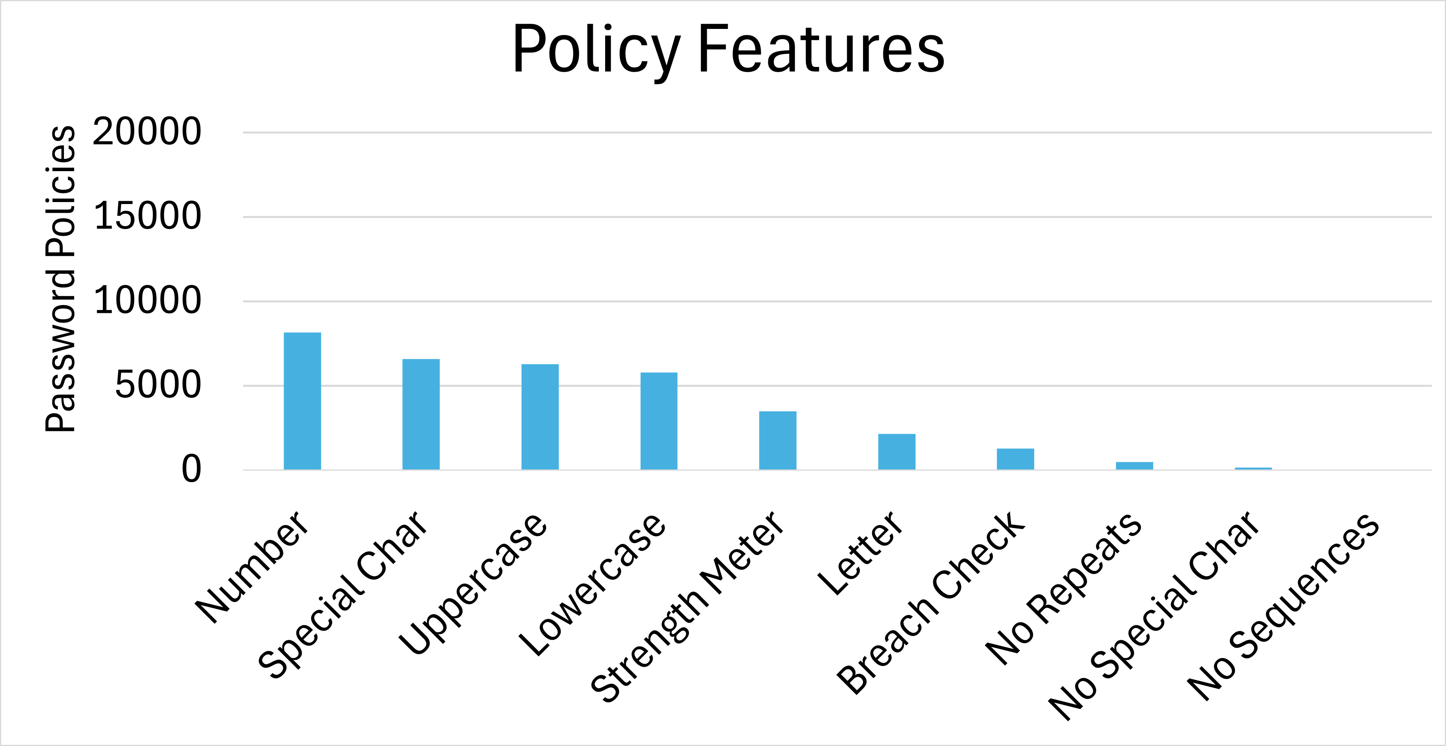
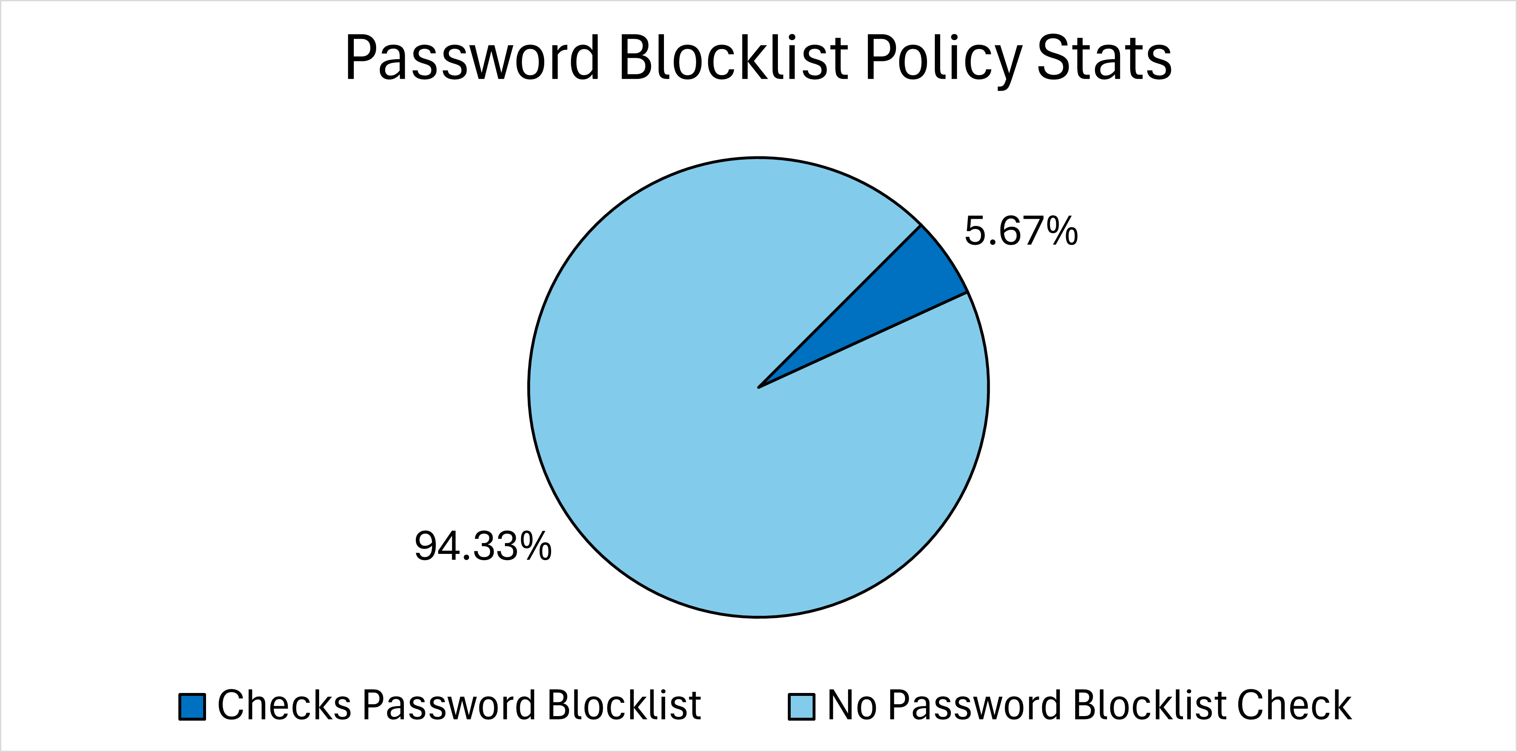
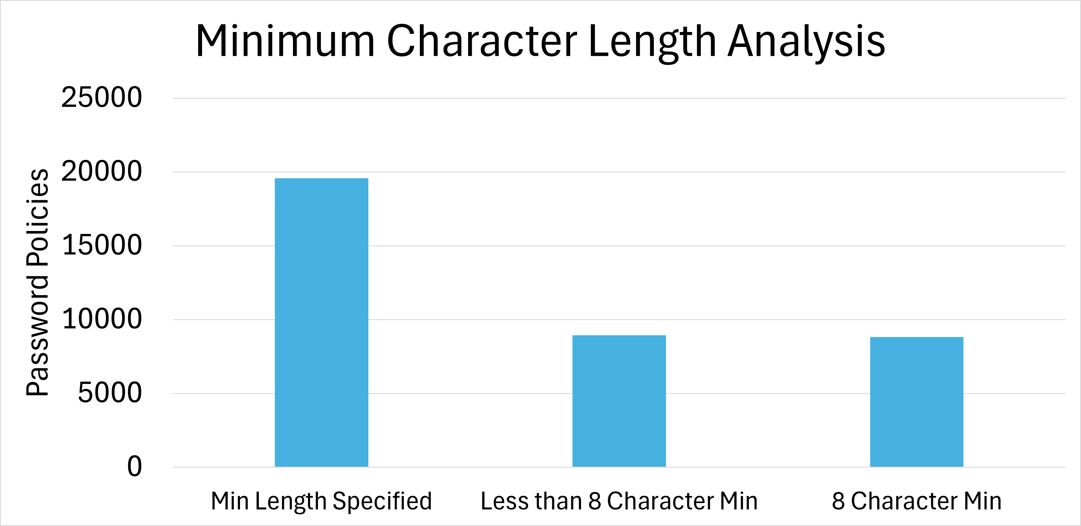
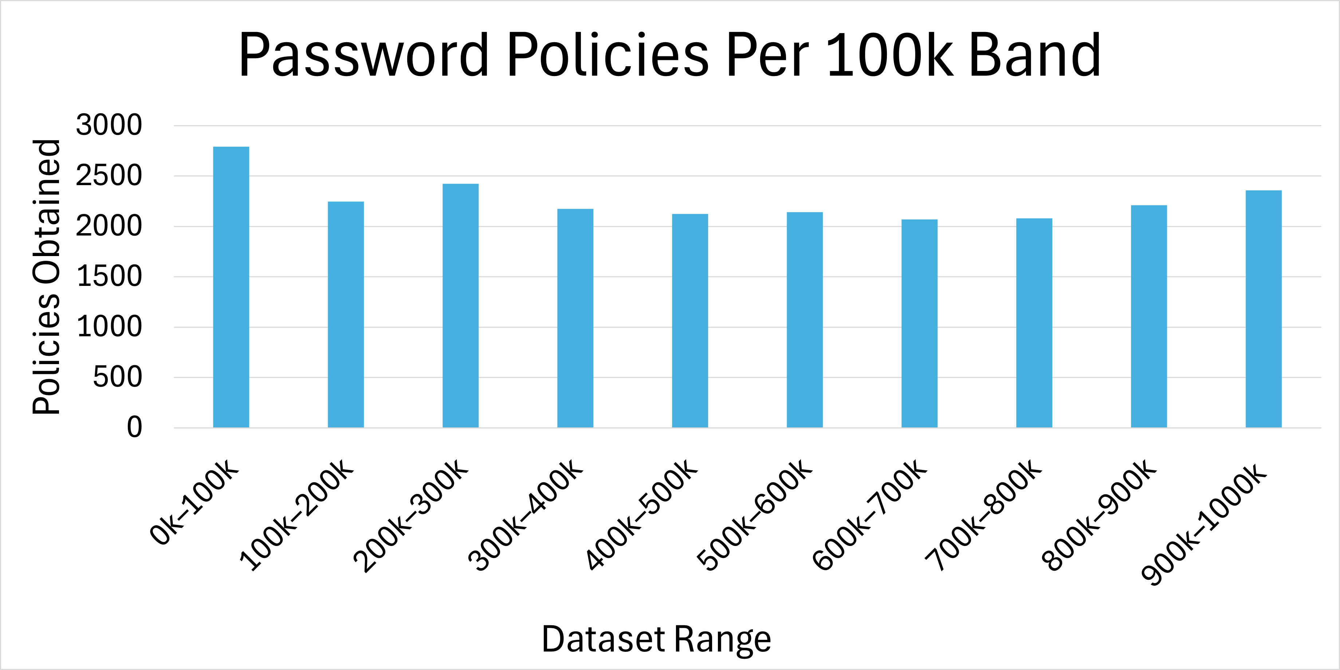
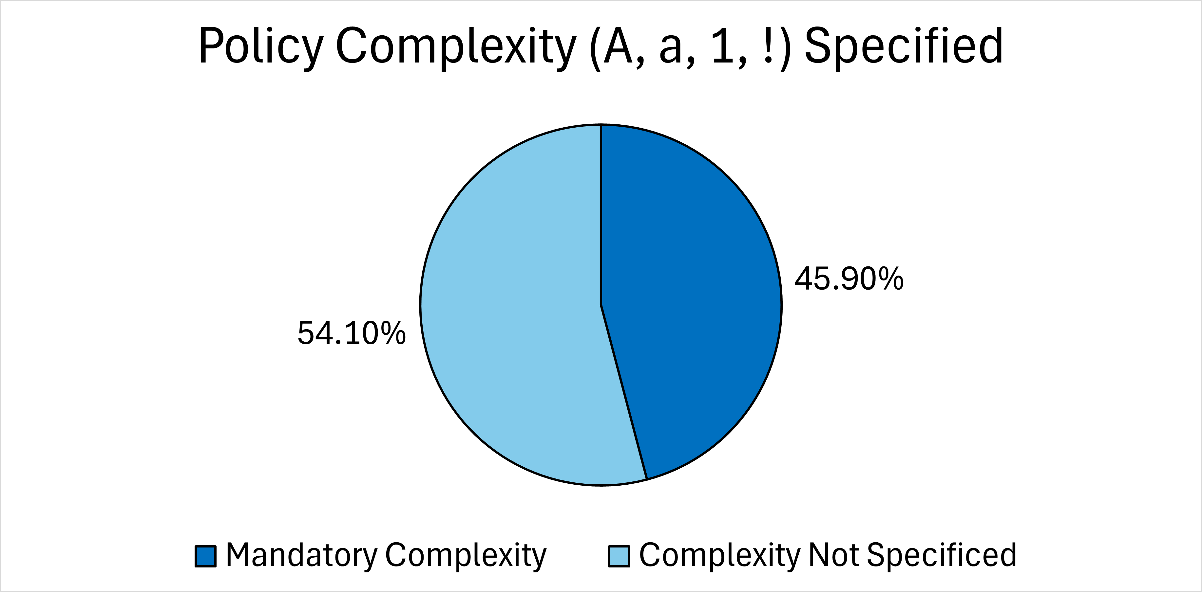
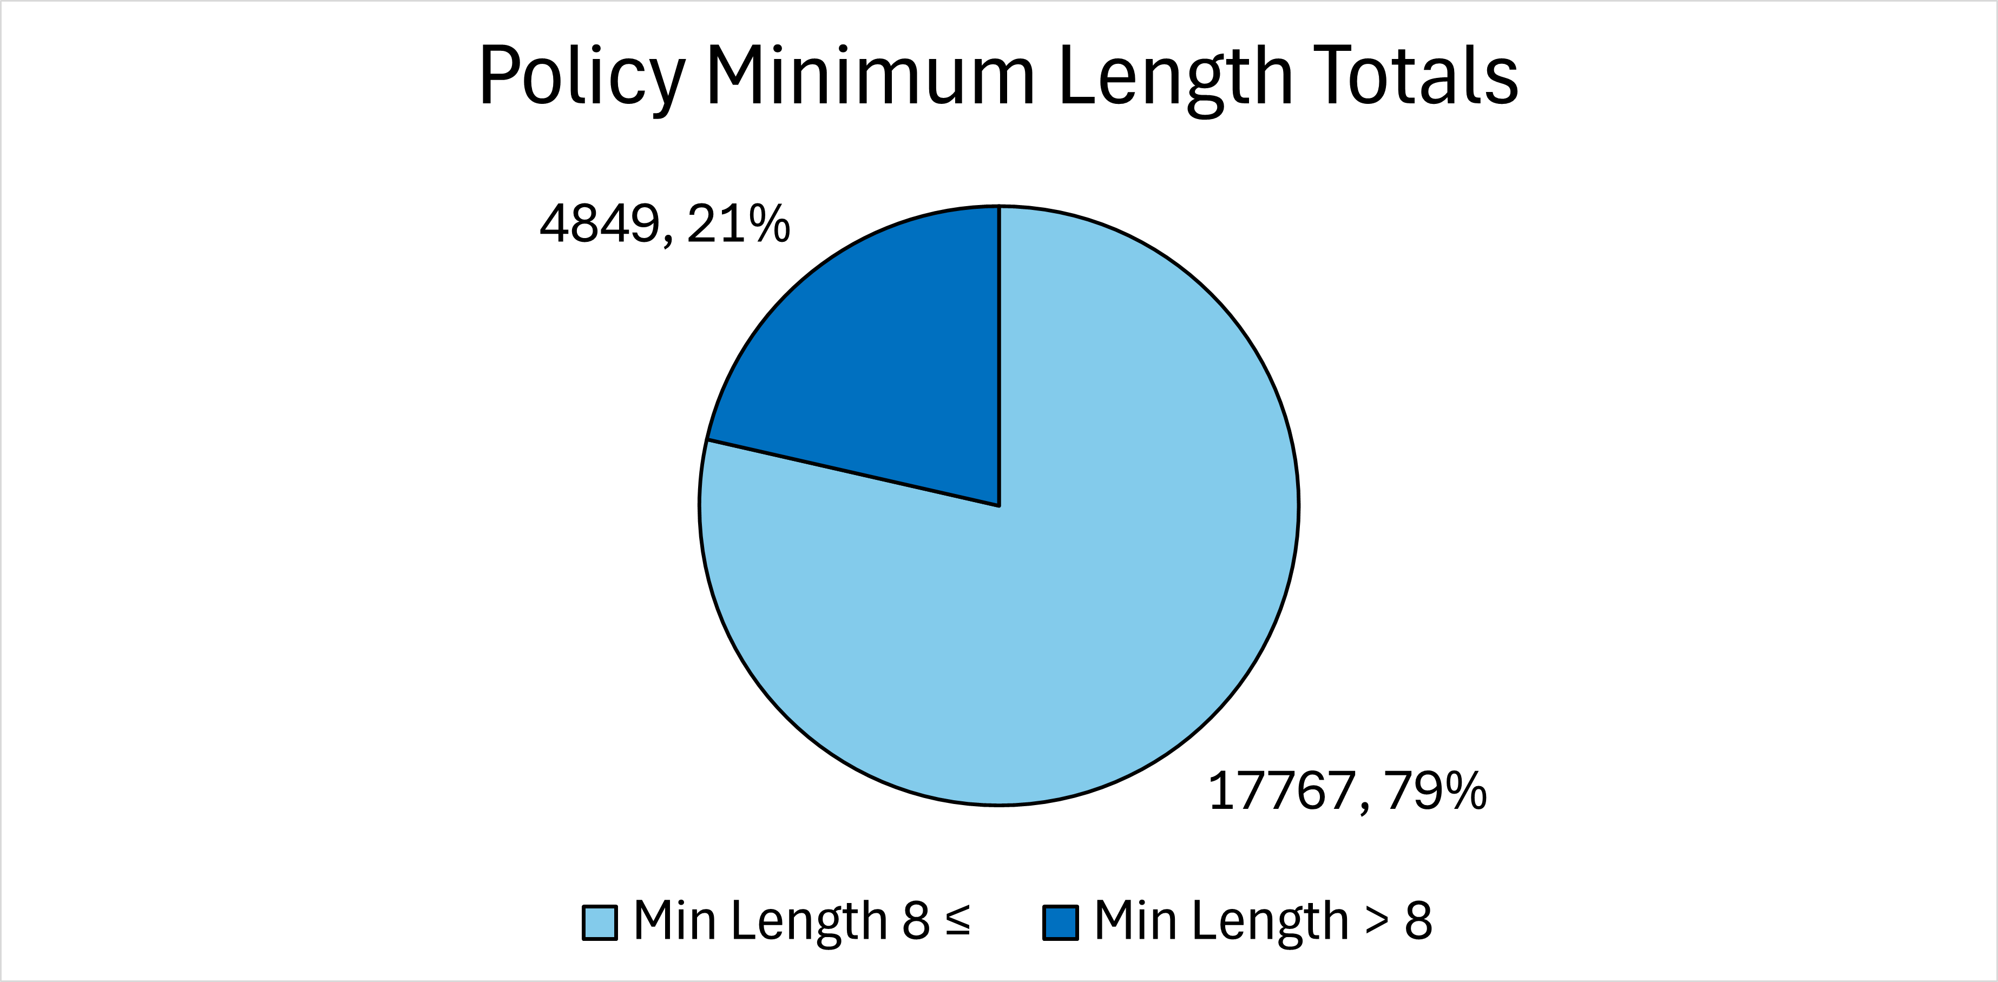
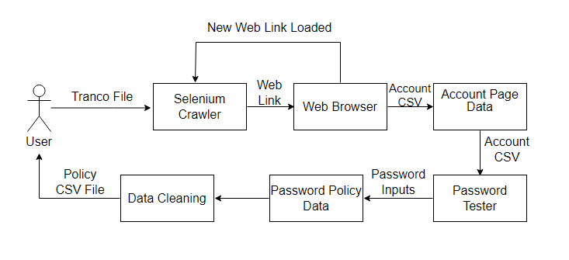
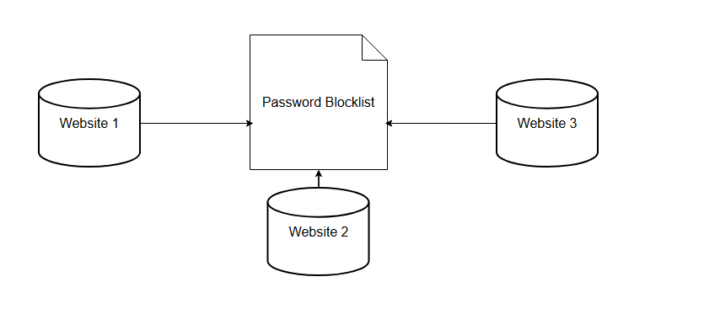
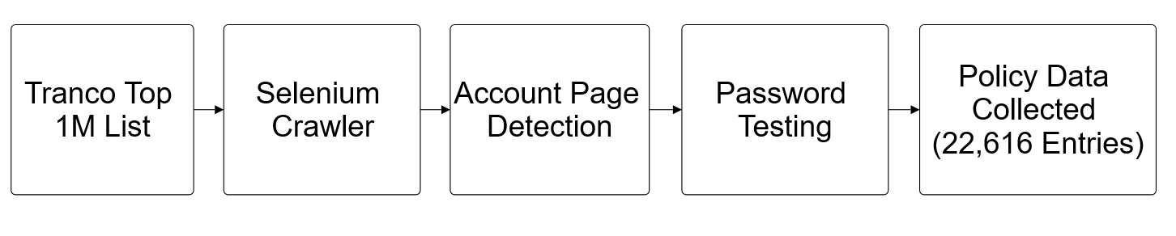
By:
Brandon Sainiak
Advisors:
Dr. Raiful Hasan
Asaf Golap
Modern Password Policy Evaluation
Abstract: 9
We gathered data from Tranco’s one million most visited websites
Policy data was analyzed to determine if they were up to modern standards
Methodology:
We used python to create a selenium crawler to detect account creation pages
Password testing was done to complete the policy data collection.
Results:
We obtained 22,616 valid password policies from the website dataset
The password policies in use are outdated by current NIST standards
Policies should be updated to check passwords with a blocklist
Introduction:
Attacks on passwords pose risk to users’ security
Password policies help users create stronger passwords
Old policies can become outdated by modern security standards
94.33% of Websites Below NIST Standards:
94.33% of websites do not check leaked password lists.
Current NIST standards are policies should not impose composition rule and should compare inputted passwords with a blocklist of commonly used or leaked passwords.
Future Work:
Analyze how policies are verifying if a password is compromised
Alterations to leaked passwords may affect whether a password is valid
References
:
NIST SP 800-63B
https://tranco-list.eu/ (Tranco 1M websites)

